Slide 1

Superloop Shuttle
Team : Naveen Dayakar Velpur
Khavya Ramachandran
Xiuwen Lin

Slide 2
INTRODUCTION
To plan a shuttle service for the students travelling between Newark and New Brunswick Rutgers Campus
Plan the operation of the shuttle, get necessary approvals and implement it within the time frame of the project
Minimize students missing classes due to the distance between the campus and encourage them to take classes from both the campus.

Slide 3
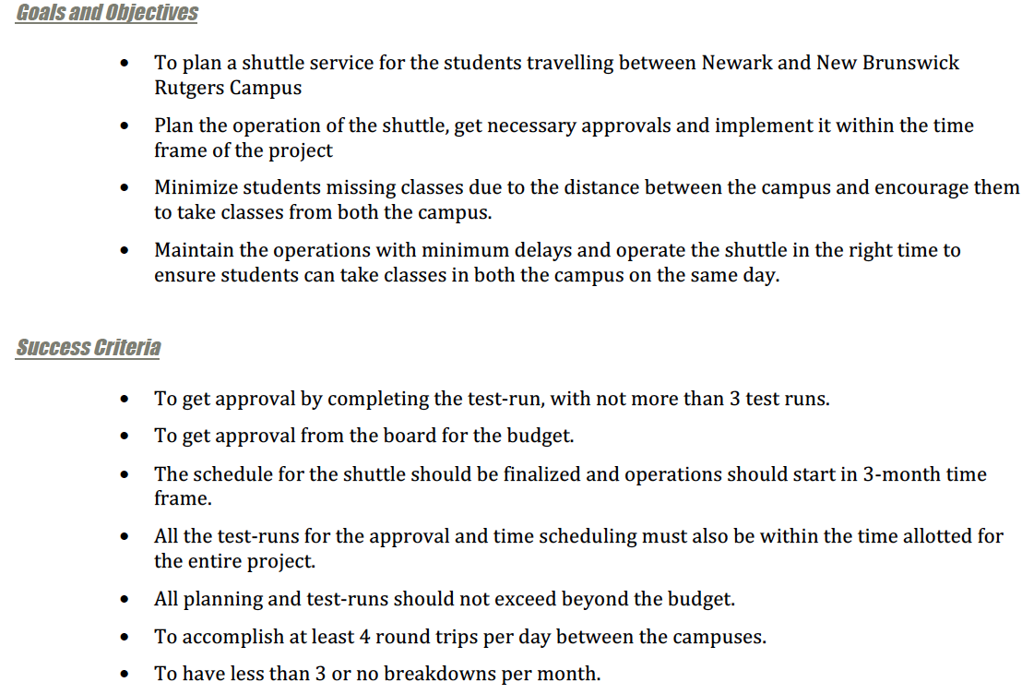
PROJECT DEFINITION DOCUMENT

Slide 4
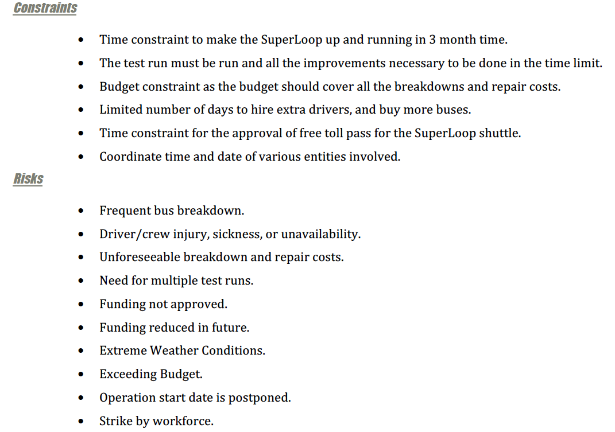

Slide 5
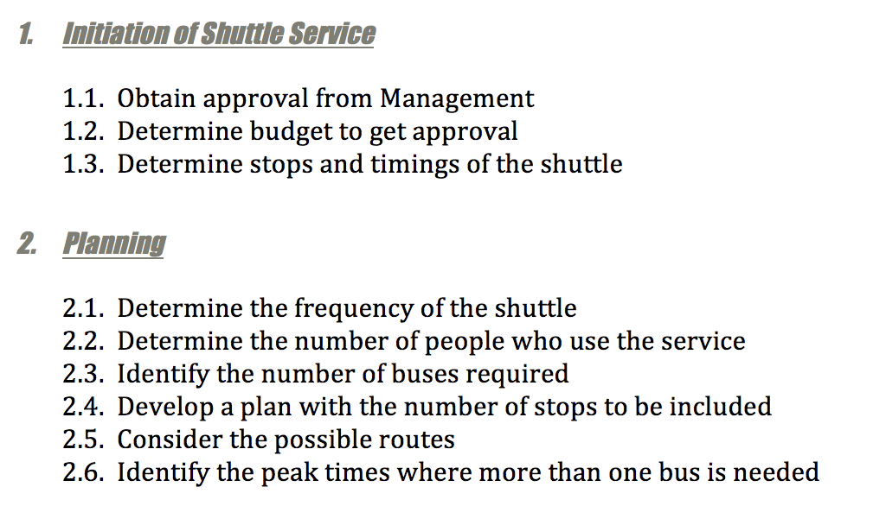
WORK BREAKDOWN STRUCTURE

Slide 6
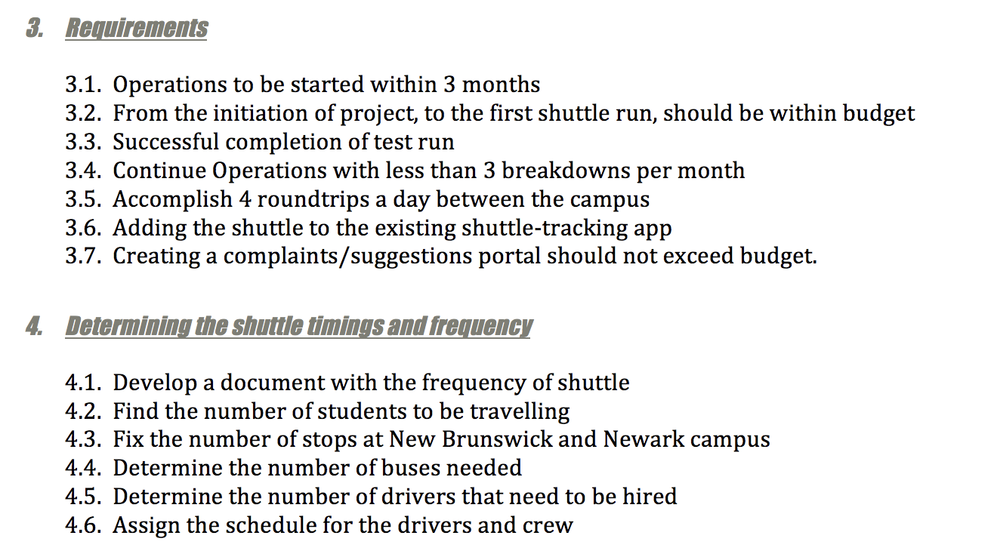
WORK BREAKDOWN STRUCTURE

Slide 7
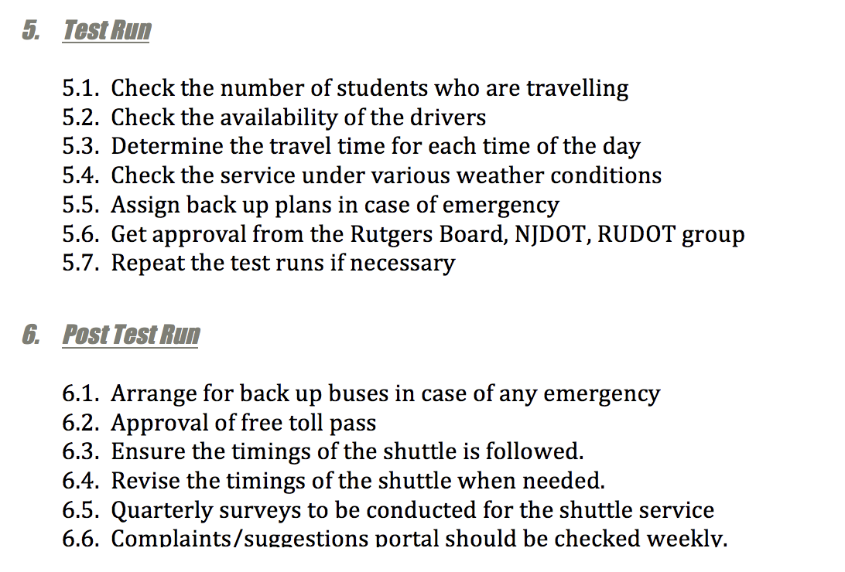
WORK BREAKDOWN STRUCTURE

Slide 8
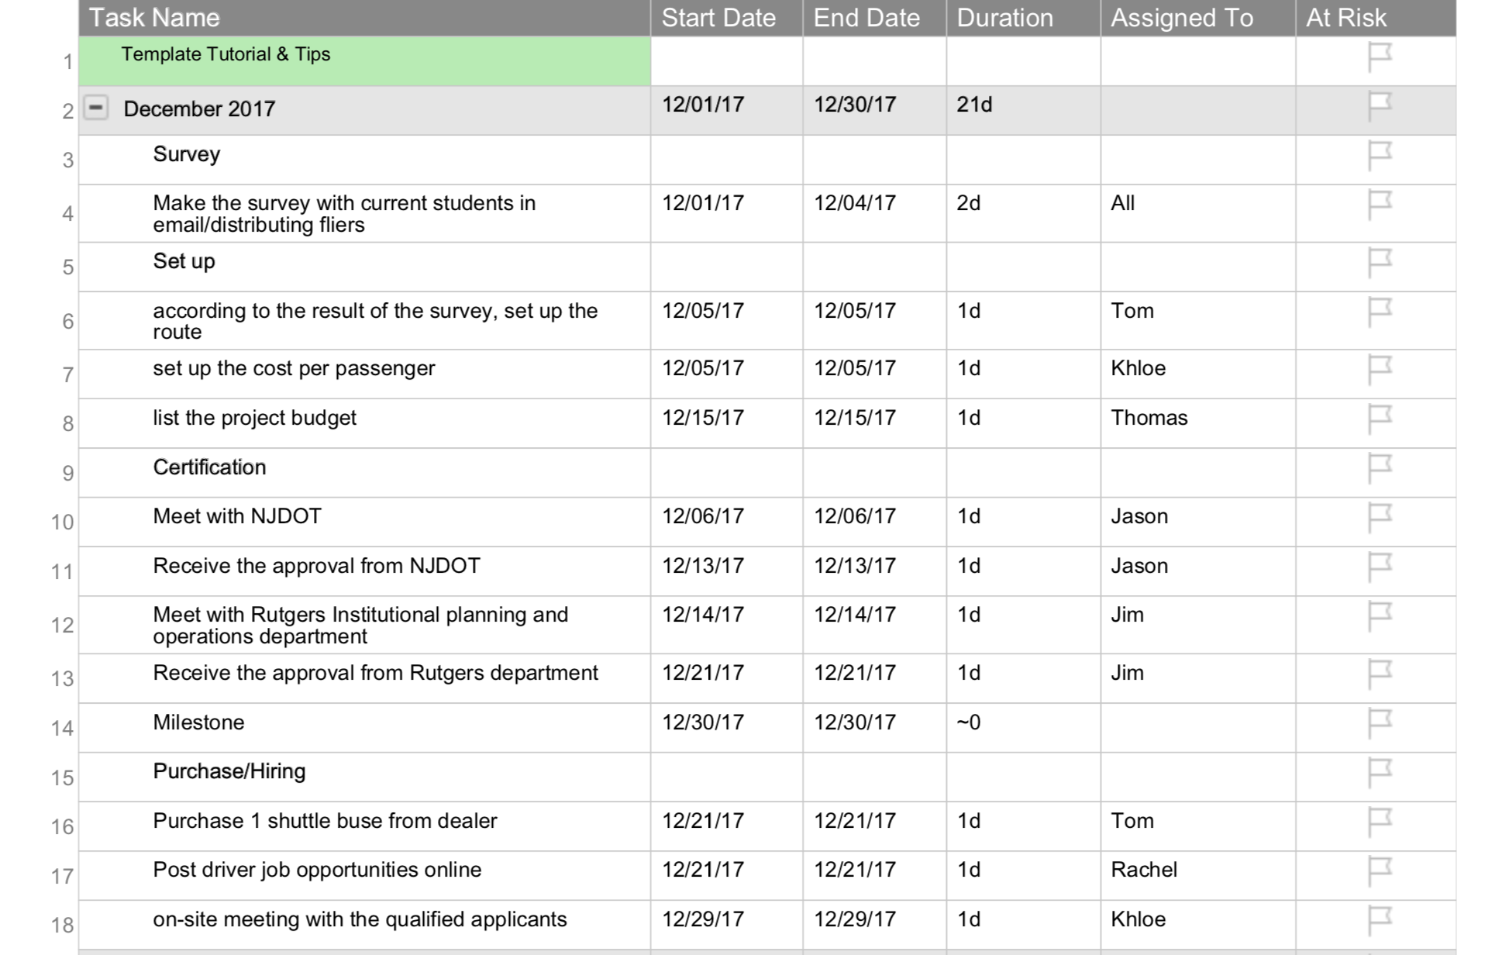
Project Schedule
1.Survey
2.Set up
3. Certification
4. Purchase/Hiring

Slide 9
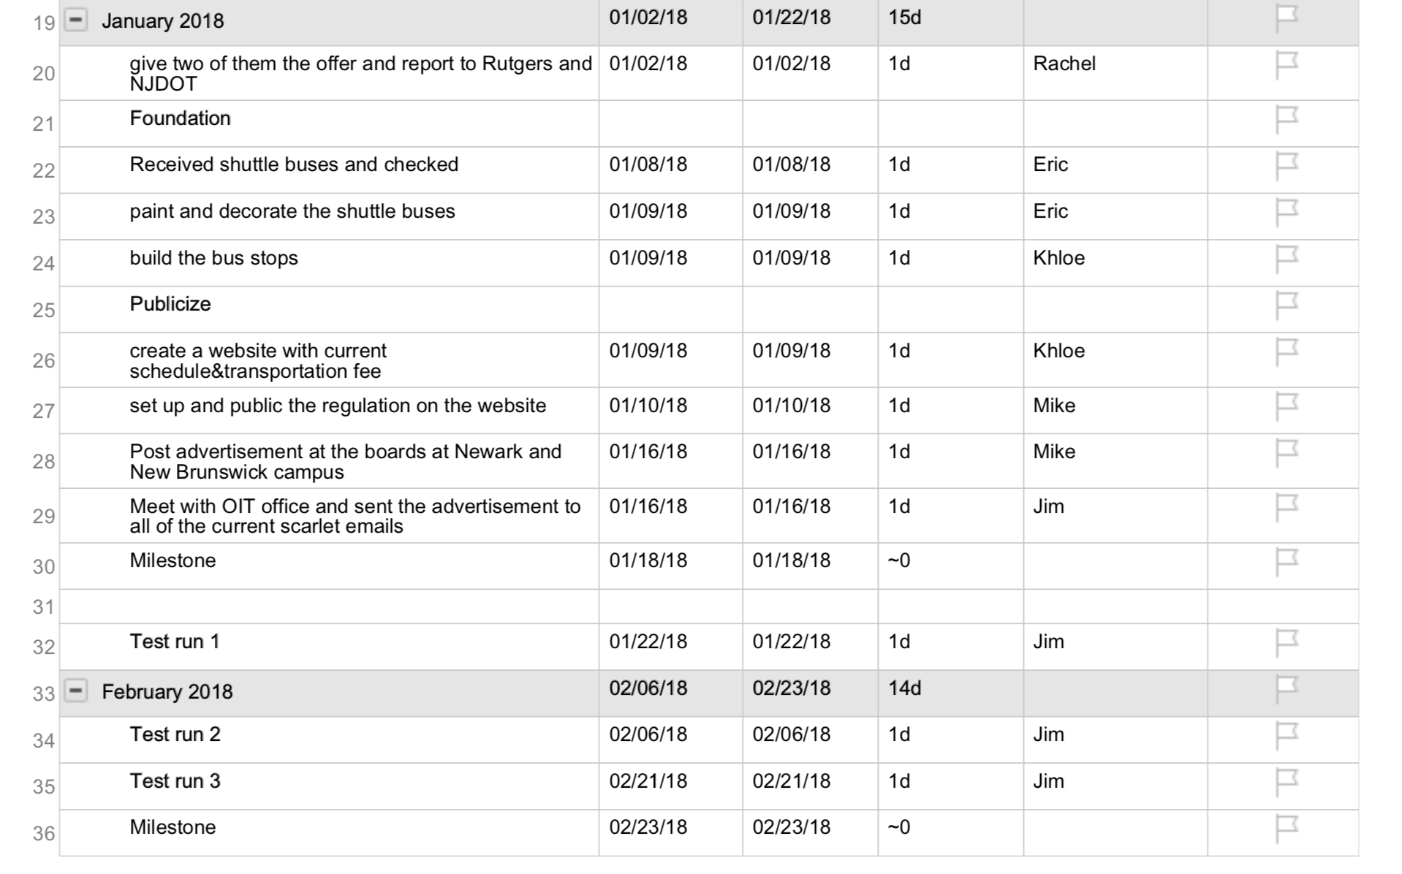
Project Schedule
5. Foundation
6. Publicize
7 Test run 1,2,3

Slide 10
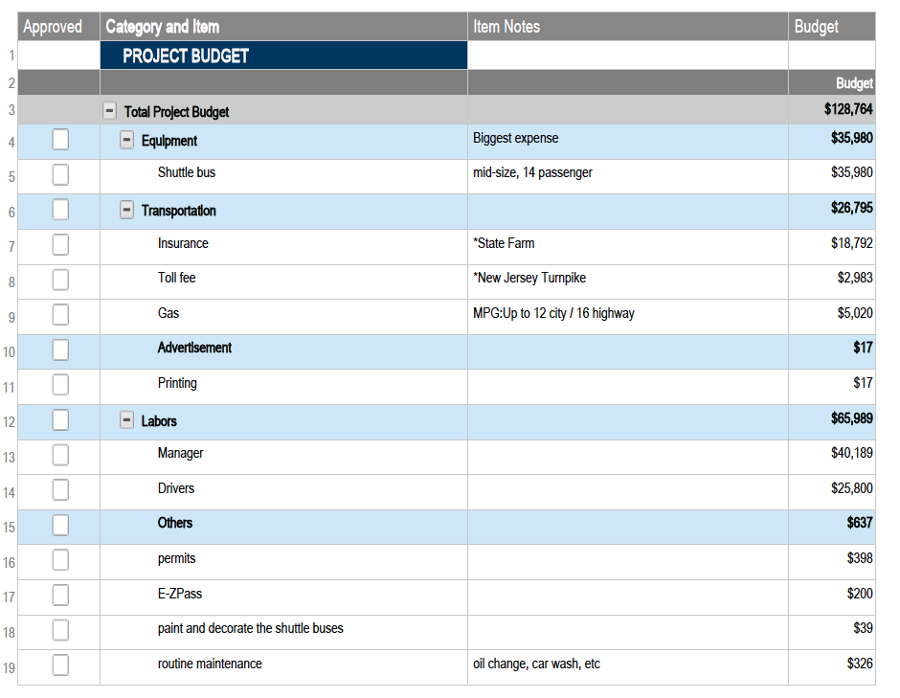
Project Budget

Slide 11
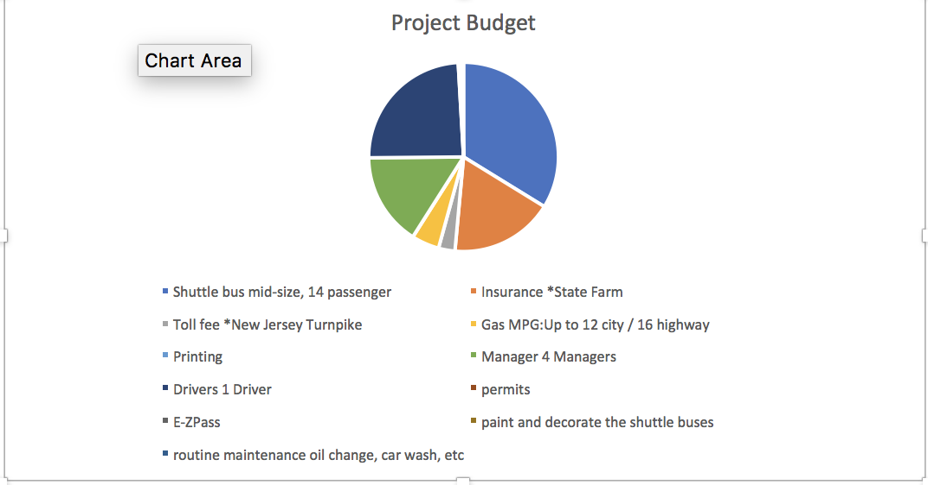
Project Budget
Budget Chart

Slide 12
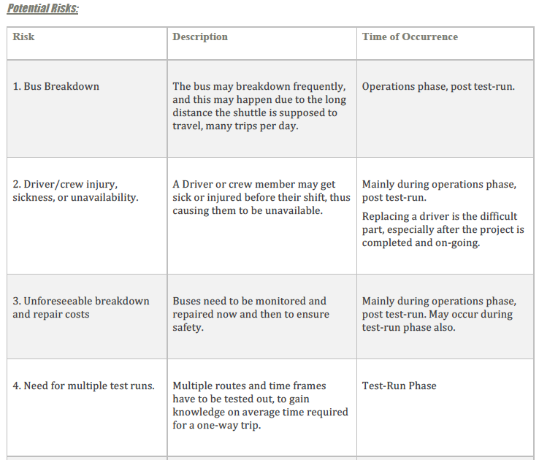
RISK MANAGEMENT PLAN

Slide 13
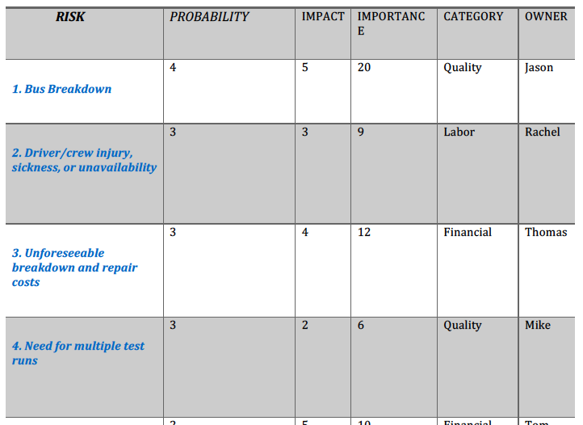
RISK PROBABILITY IMPACT MATRIX

Slide 14
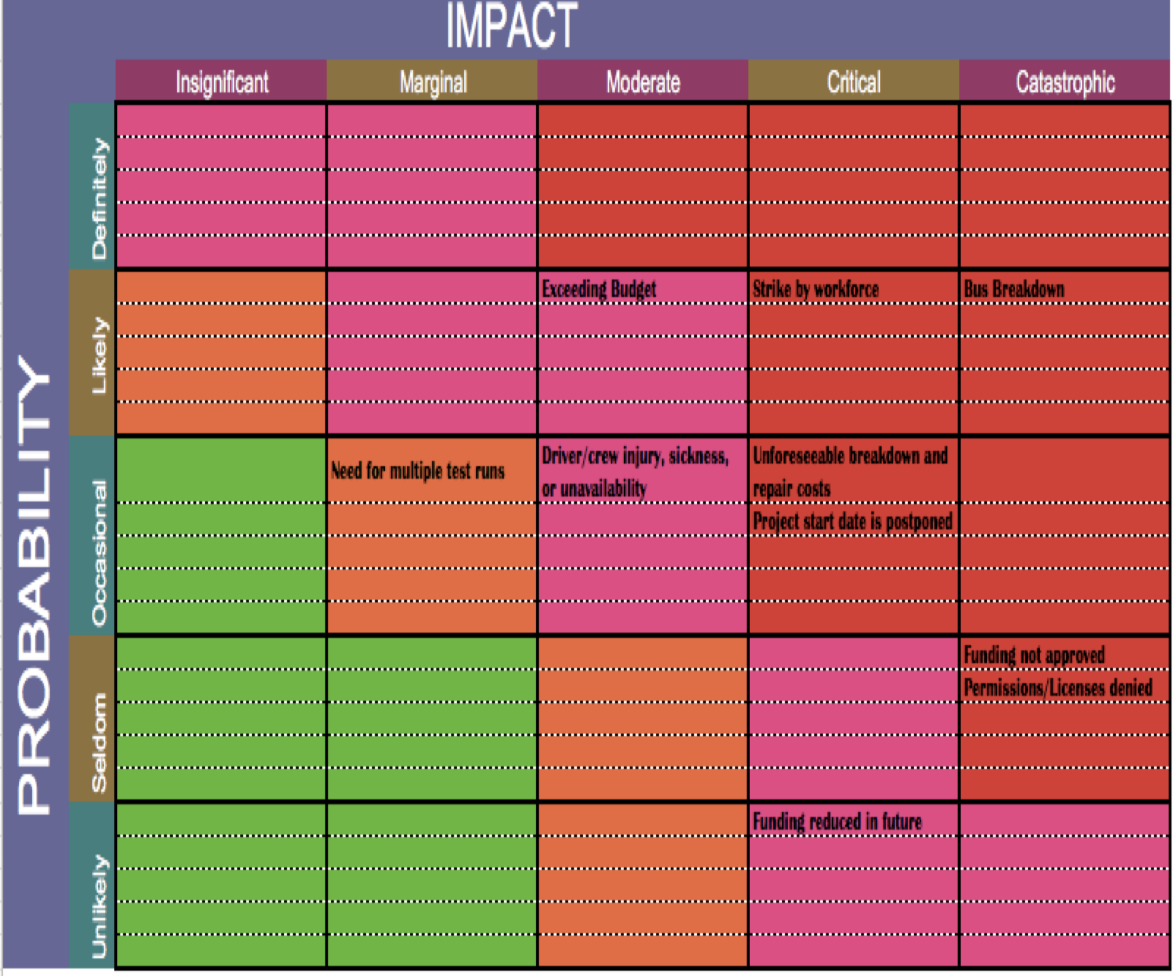
RISK SEVERITY MATRIX

Slide 15
QUALITY MANAGEMENT PLAN
Project Deliverable | Deliverable Quality Standards/ Completeness and Correctness Criteria | Quality Control Activity | Frequency/Interval
Bus condition | QC1. Conforms to expert commentary regarding bus condition | Transport authority review Board approval | Weekly
Maintenance of vehicle | QC2. Conforms to transport owner company regarding the bus maintenance. | Transport authority review | Monthly
Shuttle service stops | QC3. Conforms to | Board approval | Yearly

Slide 16
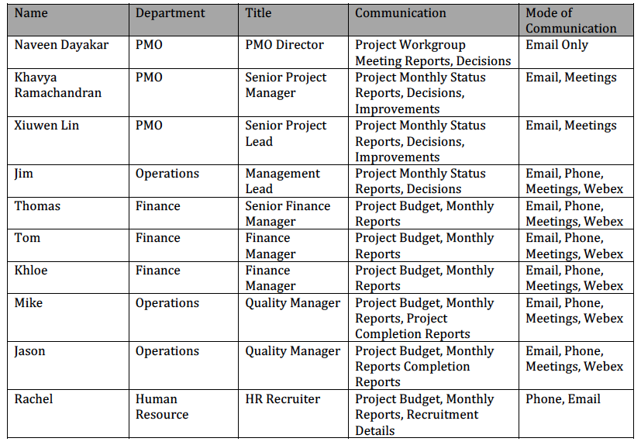
STAKEHOLDER COMMUNICATION MATRIX

Slide 17
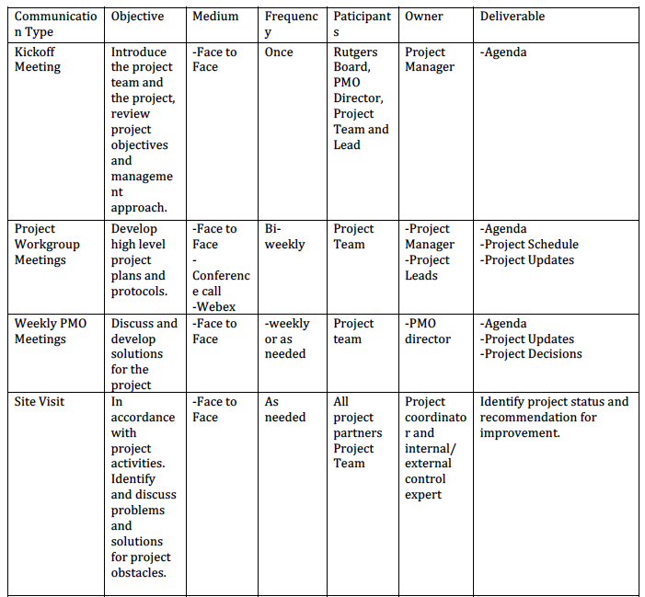
COMMUNICATIONS MATRIX

Slide 18
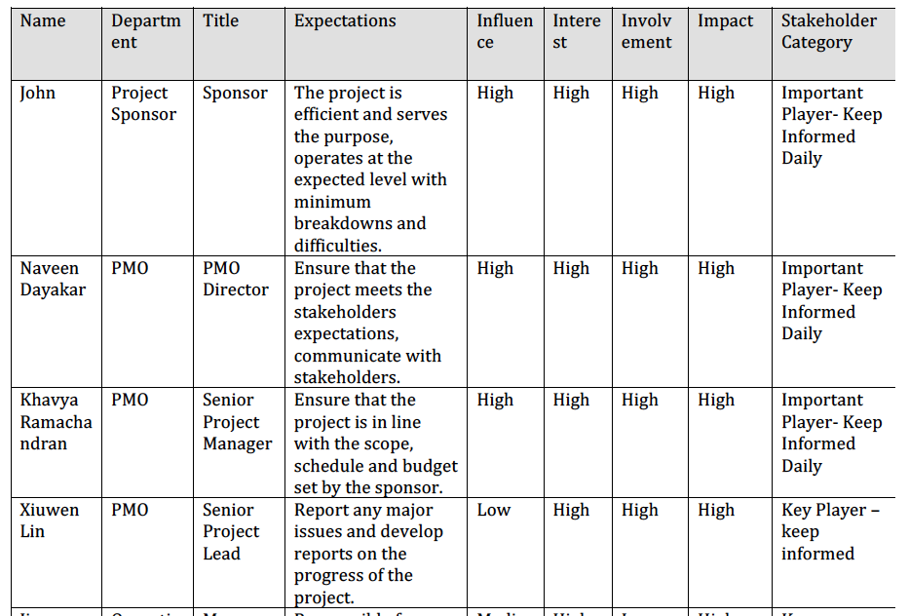
STAKEHOLDERS ANALYSIS MATRIX

Slide 19
THANK YOU

